Slide 1
Information & Systems Security Society
INTRO TO DATABASES
HOW TO STORE YOUR DATA

Slide 2
Imagine this scenario
~3TB data/month

Slide 3
What are your design requirements?
Persistence
Easy
Powerful

Slide 4
https://www.youtube.com/watch?v=Xpc0s9FsA1Q

Slide 5
So how do they (databases) work
Need a consistent and quick search
Most databases use B+ trees, which is just a balanced tree for trees that have more than two children nodes
O(log(n)) is usually fast enough
Need data to persist and be reliable
Transactions

Slide 6
What do Transactions Ensure
Concurrency. You will be able to handle a lot of traffic at once
Durability. Your data will stick
Serializability. Transactions will happen one after another.

Slide 7
How do they work?
Synchronize each request (use a lock or binary semaphore)
This will ensure that you are handling one request at a time rather than overwriting data that you might need
Keep a log on disk of all changes, so that if your database gets screwed, you can just redo all of the changes made
As you handle each request add more to this log
If the transaction is ”committed”, we know it is done and can be written to the log. Otherwise, roll back operations as if they haven’t occurred

Slide 8
So that’s like enough about the low level stuff
If you’d like to learn more, take OS and have this person as your TA
And work at VMWare or something, idk.

Slide 9
Alright, high level time.
How do you get a database?
Host it locally or use some cloud hosting service (AWS/Azure/GCP)
How do you connect to a database?
Use a connector with the language of your choice
Or connect directly to it via command line

Slide 10

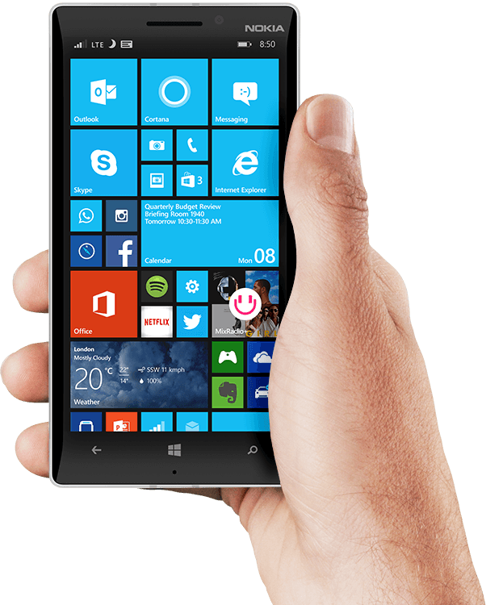
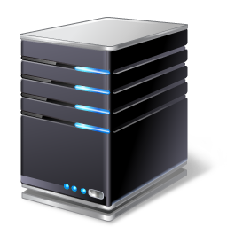
Your Sick App: Tinder for __________________
MySQL for Windows, Unix, Mac, etc.
Dank
Memezzzz
Value
Database
Server*
Row/ Entry
Table
Phone, browser, game, executable, etc.
The Internet
PHP/Apache, Node.js, Python, etc. on Windows, Unix, or Mac OS

Slide 11
How to Design Your Sick App: Tinder for __________________
Dank
Memezzzz
You need:
A place to store memes
Solution: Create a table in your database
A place to store users
Solution: Create a table in your database

Slide 15
How many mountain dews were in this presentation?

